Slide 1
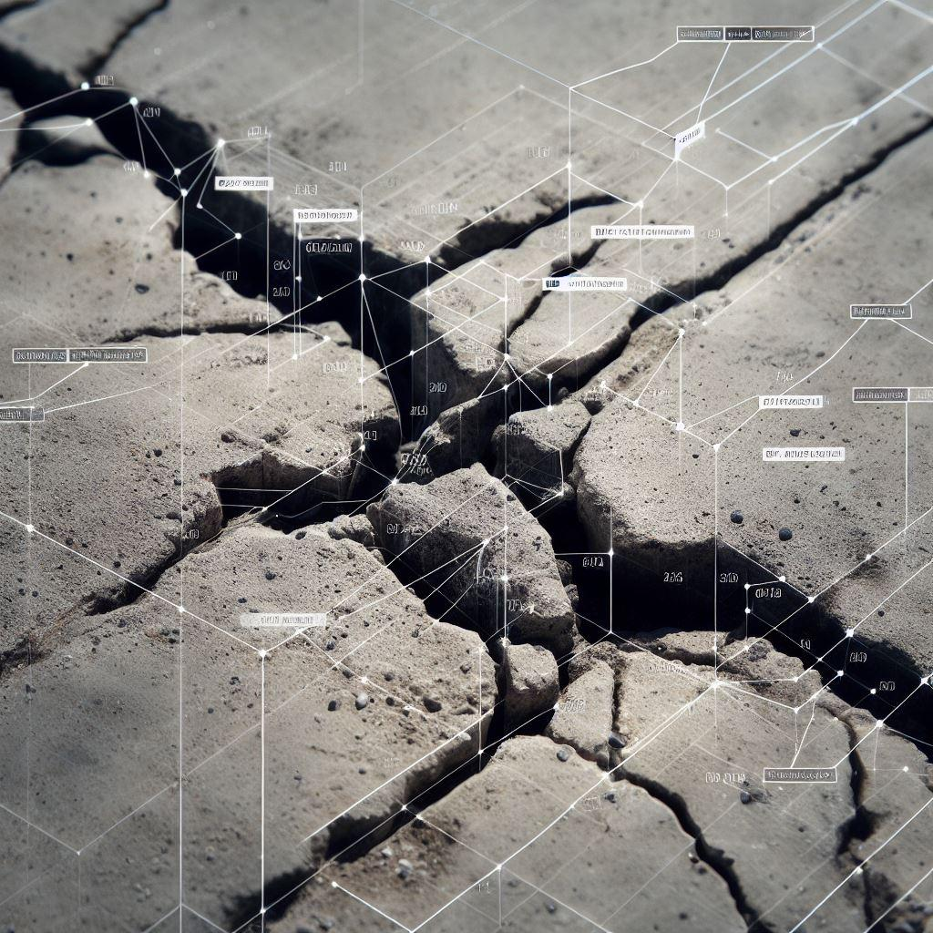


IITB - Accenture
Fine-Grained Crack
Detection using
Transformer Network
Professors:
Biplab Banerjee
Rajbabu Velmurugan
Students:
Jaideep Kotani (B.Tech.)
Gnanendar Reddy (B.Tech.)
Priyanka Talwar (Ph.D.)
14th Nov, 2023

Slide 2
Existing Works on Crack Detection (1 of 3)
Wind turbine blade defect detection using hyperspectral imaging ¹
Application of hyperspectral imaging on aircraft damage inspection ²
Hyperspectral imaging applied for the detection of wind turbine blade damage and icing ³
Classification of In-Flight Fatigue Cracks in Aircraft Structures using Acoustic Emission and Neural Networks ⁴
Rizk, Patrick, et al. "Wind turbine blade defect detection using hyperspectral imaging." Remote Sensing Applications: Society and Environment (2021):
Ma, Yandy, Anthony Mannion, and Stephen O'Brien. "Application of hyperspectral imaging on aircraft damage inspection." Optical Metrology and Inspection for Industrial Applications,. SPIE, 2018.
Rizk, Patrick, et al. "Hyperspectral imaging applied for the detection of wind turbine blade damage and icing." Remote Sensing Applications: Society and Environment (2020)
Rovik, Christopher Lee. Classification of in-flight fatigue cracks in aircraft structures using acoustic emission and neural networks. Embry-Riddle Aeronautical University, 1998.

Slide 3
Existing Works on Crack Detection (2 of 3)
A review of deep learning methods for pixel-level crack detection ¹
Pavement Crack Detection from Hyperspectral Images Using a Novel Asphalt Crack Index²
Assessment of Crack Detection in Heavy-Walled Cast Stainless Steel Piping Welds Using Advanced Low-Frequency Ultrasonic Methods ³
5Li, Hongxia, et al. "A review of deep learning methods for pixel-level crack detection." Journal of Traffic and Transportation Engineering (English Edition) (2022).
Abdellatif, Mohamed, et al. "Pavement crack detection from hyperspectral images using a novel asphalt crack index." Remote sensing 12.18 (2020)
Anderson, Michael T., et al. Assessment of crack detection in heavy-walled cast stainless steel piping welds using advanced low-frequency ultrasonic methods. Pacific Northwest National Lab.(PNNL), Richland, WA (United States), 2007.

Slide 4
Existing Works on Crack Detection (3 of 3)
CrackFormer¹: A novel Transformer network that uses self-attention and scaling-attention mechanisms to detect fine-grained cracks from images
Self-Attention: Self-Attention blocks with 1x1 convolution kernels and position embedding are used to extract contextual information across feature channels and spatial domains, and capture long-range interactions between crack pixels
Scaling-Attention: for sharpening crack. Scaling-Attention blocks generate attention masks from encoder features and apply them to decoder features, which can suppress non-crack features and enhance crack crispness that sharpens cracks
Liu, Huajun, et al. "Crackformer: Transformer network for fine-grained crack detection." Proceedings of the IEEE/CVF International Conference on Computer Vision. 2021.

Slide 5
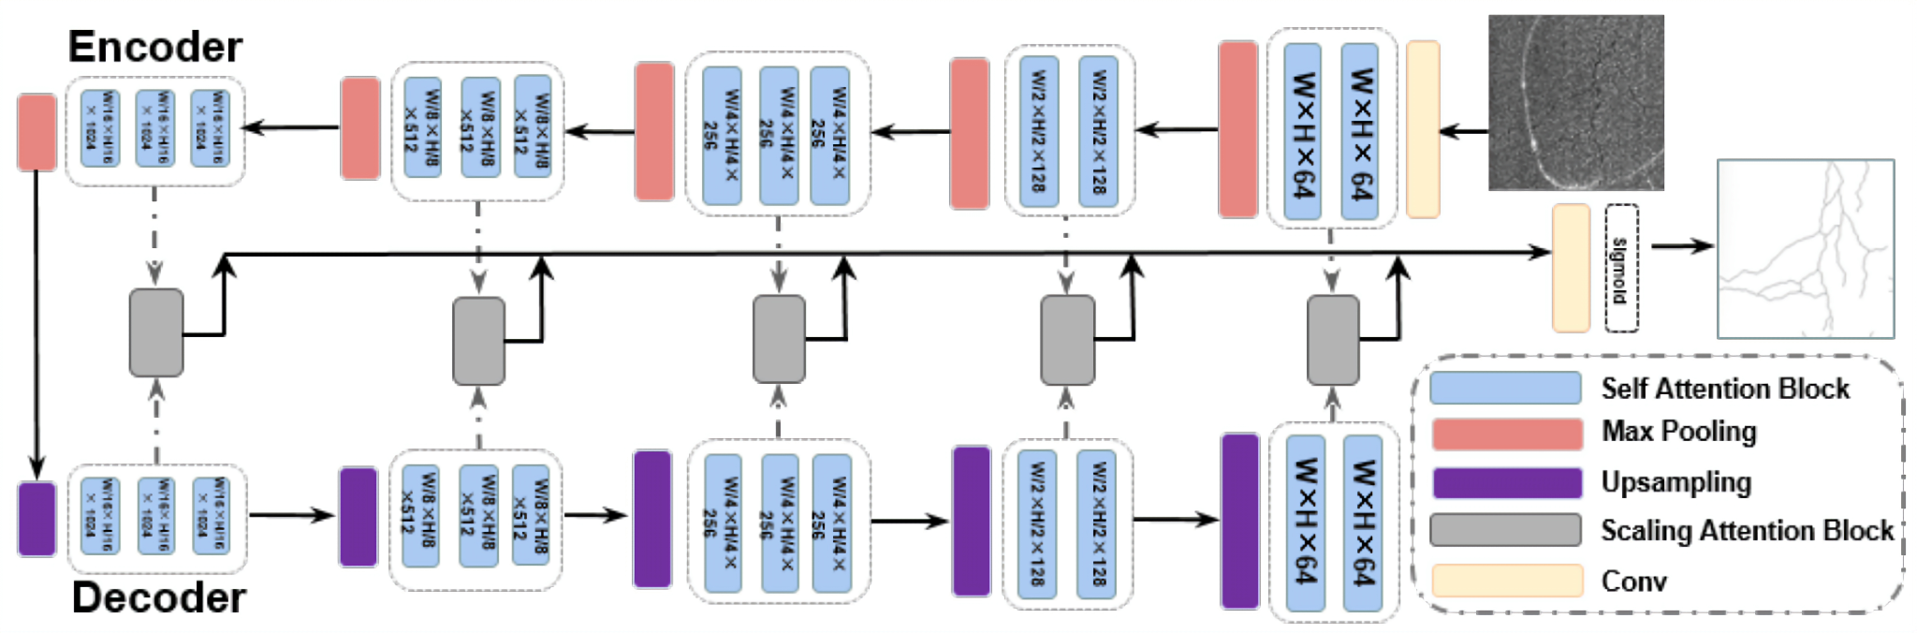
Structure of the Crack Former¹ Network
Liu, Huajun, et al. "Crackformer: Transformer network for fine-grained crack detection." Proceedings of the IEEE/CVF International Conference on Computer Vision. 2021.

Slide 6
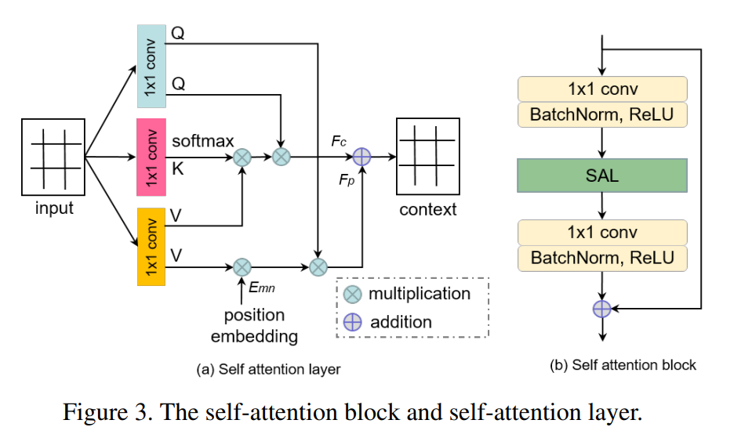
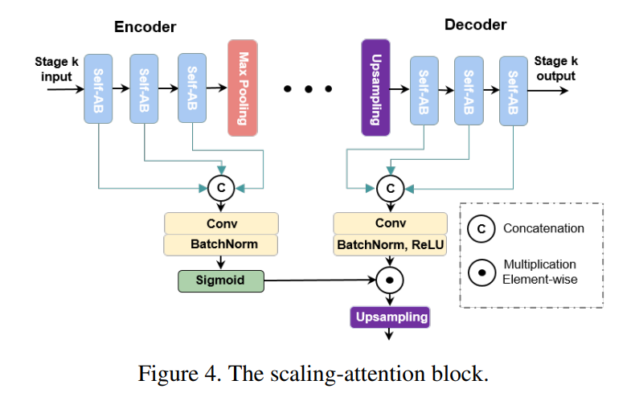
Novelty in Crack Former¹ Network
Liu, Huajun, et al. "Crackformer: Transformer network for fine-grained crack detection." Proceedings of the IEEE/CVF International Conference on Computer Vision. 2021.

Slide 7
Metrics used in Crack Former
Three different F-measure-based metrics are employed in the evaluation.
Optimal Image Scale (OIS): the aggregate F-measure on the data set for the best threshold on each image
Optimal Dataset Scale (ODS): the best F-measure on the data set for a fixed threshold
Average precision (AP): is equivalent to the area under the precision-recall curve

Slide 8
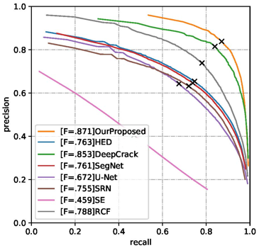
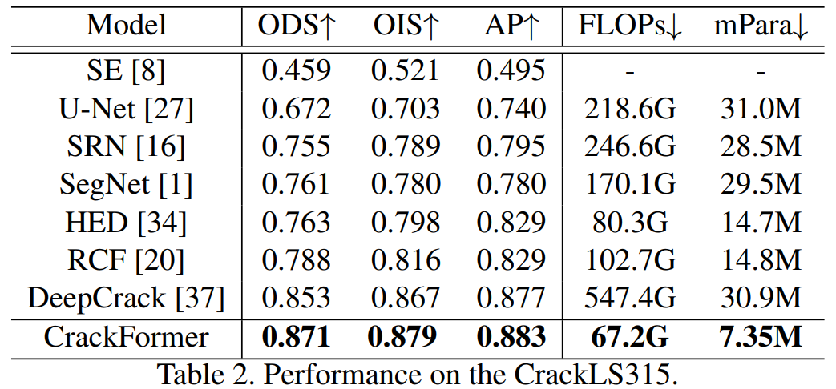
Results of CrackFormer¹
The table shows the comparison of metrics with various other models and the plot is precision recall of CrackLS315 dataset
Liu, Huajun, et al. "Crackformer: Transformer network for fine-grained crack detection." Proceedings of the IEEE/CVF International Conference on Computer Vision. 2021.

Slide 9
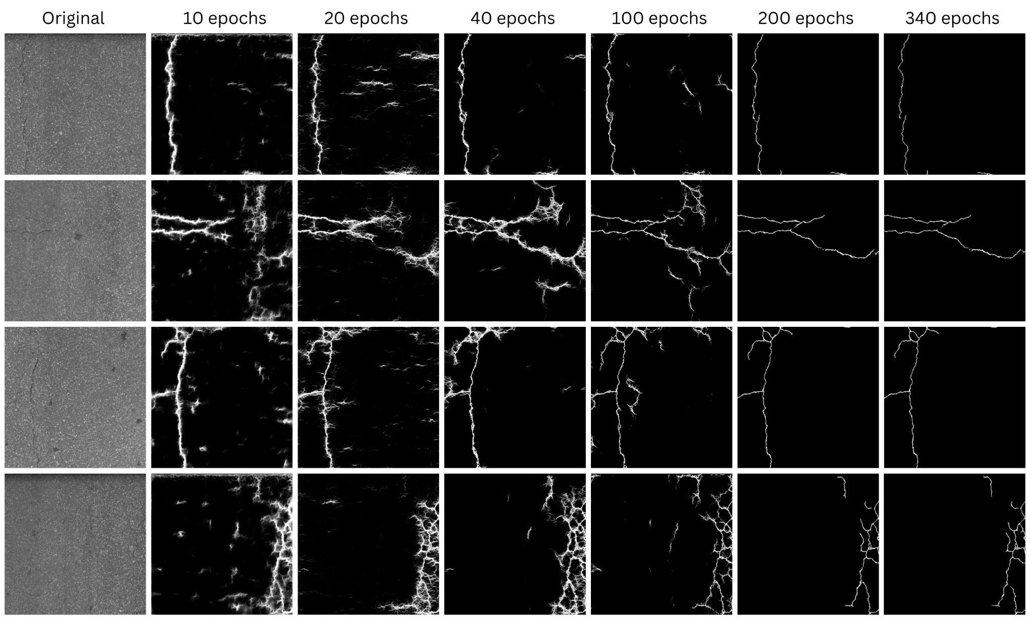
Results of CrackFormer

Slide 10
Approach to Improve CrackFormer
Initial model solely relies on pixel-level detection. Our goal is to augment its accuracy and efficiency by integrating patch-level crack detection across all attention blocks
We introduced a binary classifier employing sigmoid activation within each attention layer
This classification process aids decision-making by amalgamating pixel-level outputs with patch-level analysis, expediting crack prediction and reducing training duration as a consequence

Slide 11
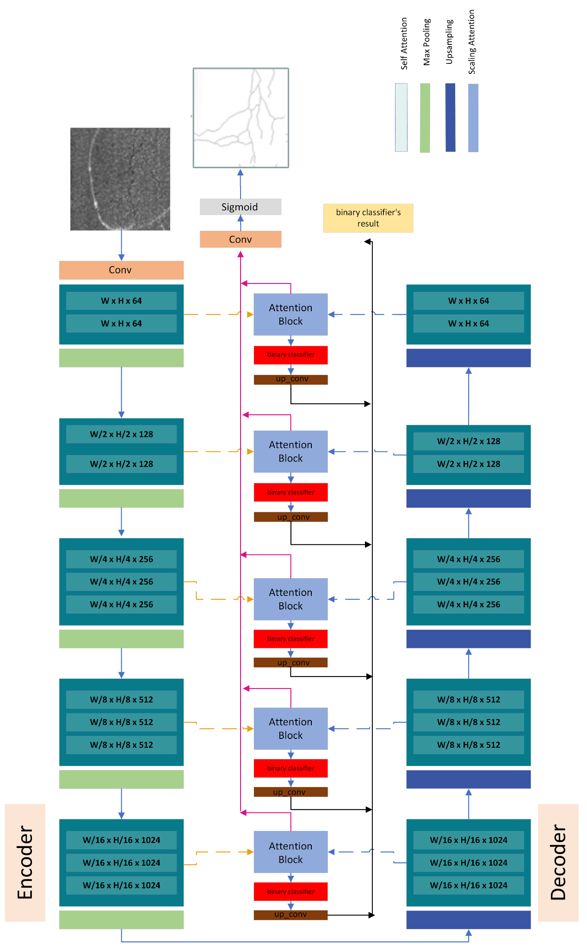
Proposed CrackFormer Structure

Slide 12
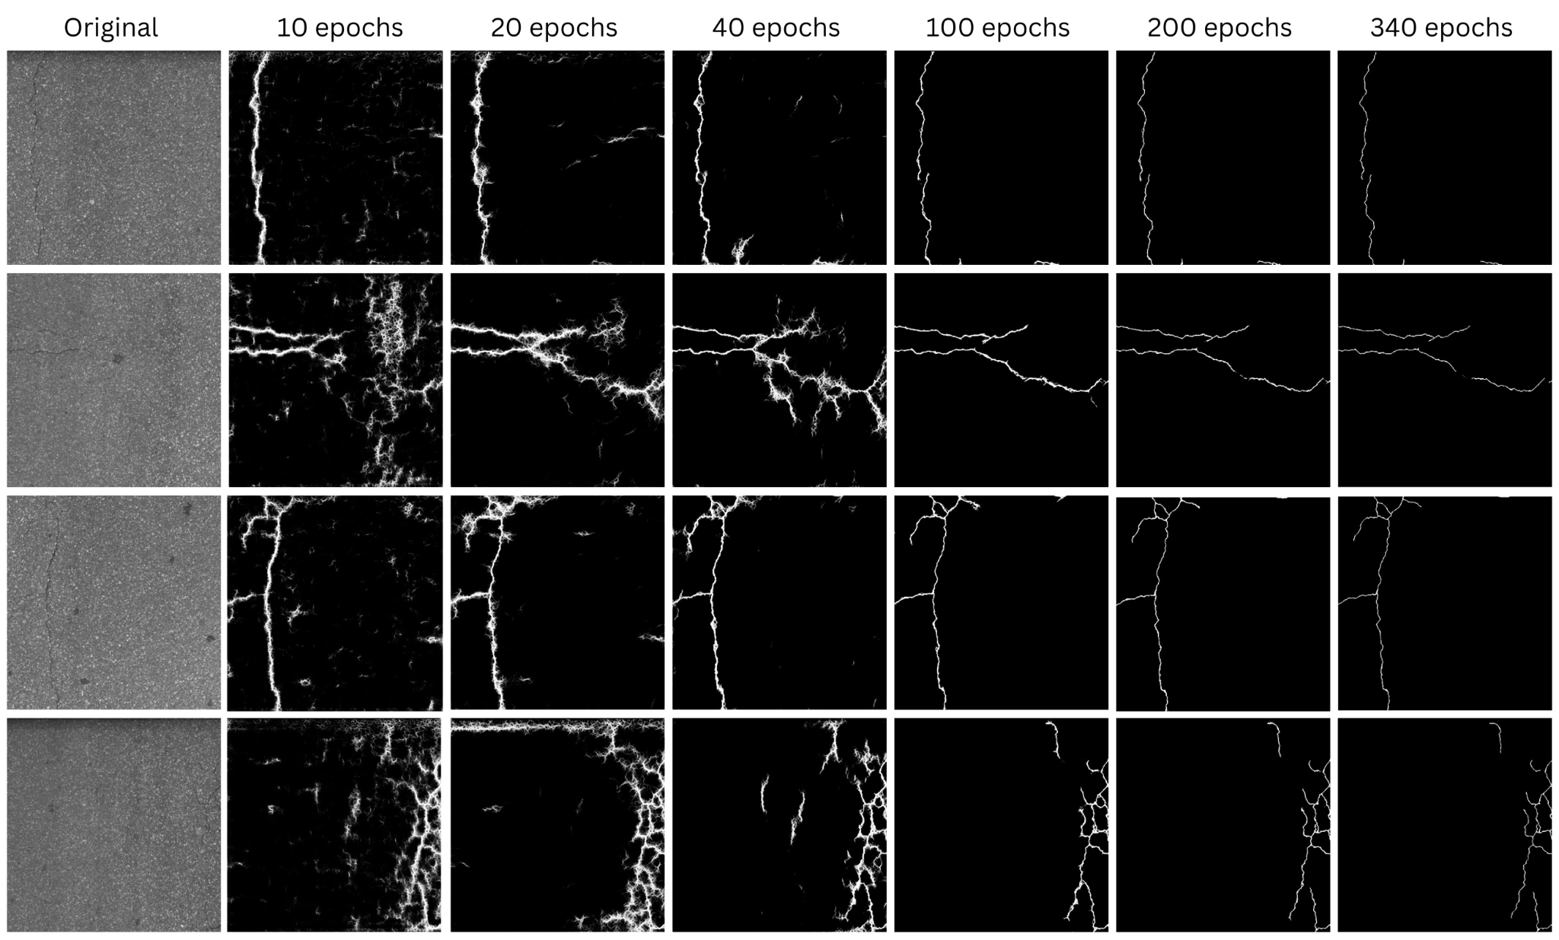
Results of Proposed CrackFormer

Slide 13
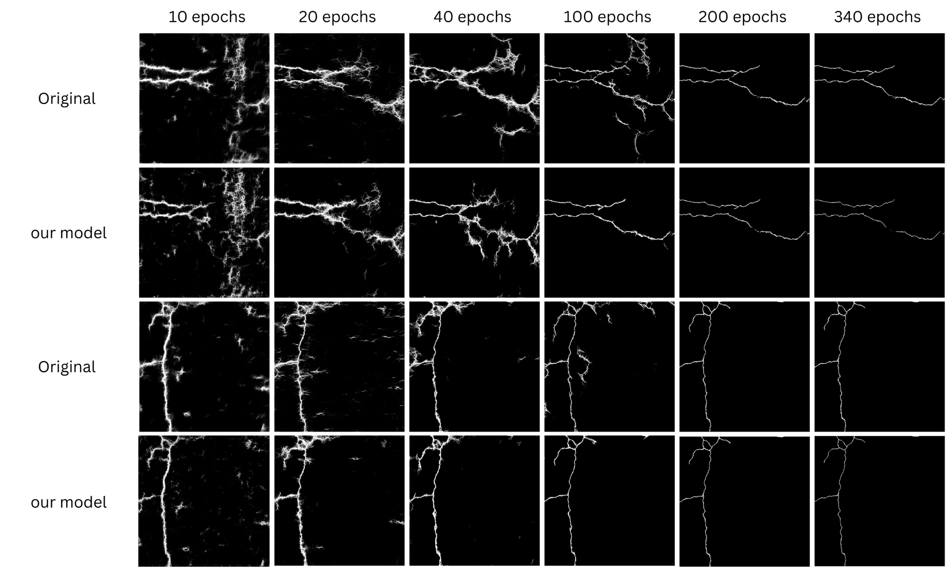
Comparison of both models
We achieved convergence lot early than crackformer

Slide 14
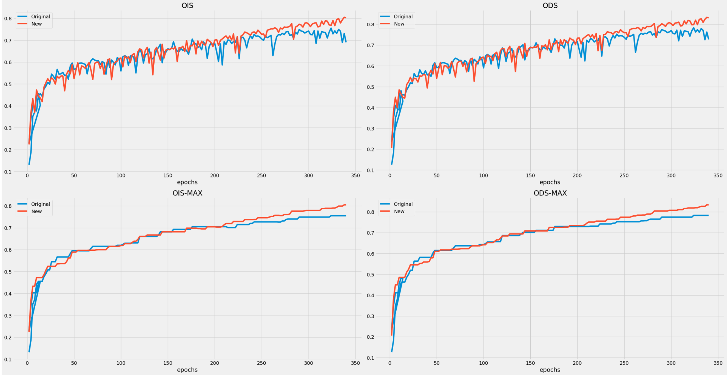
Comparison of metrics
OIS, ODS comparison and saturation of both OIS and ODS compared along the time

Slide 15
Future Work
Leverage both the loss probability from the Binary Classifier and the RCF loss from the main pipeline, reflecting the combination of the weak supervised model with the Transformer network
Testing will encompass a range of datasets, including different types such as pavement cracks, cracks on rocks, and more

Slide 16
References
Rizk, Patrick, et al. "Wind turbine blade defect detection using hyperspectral imaging." Remote Sensing Applications: Society and Environment 22 (2021): 100522.
Ma, Yandy, Anthony Mannion, and Stephen O'Brien. "Application of hyperspectral imaging on aircraft damage inspection." Optical Metrology and Inspection for Industrial Applications V. Vol. 10819. SPIE, 2018.
Rizk, Patrick, et al. "Hyperspectral imaging applied for the detection of wind turbine blade damage and icing." Remote Sensing Applications: Society and Environment 18 (2020): 100291.
Rovik, Christopher Lee. Classification of in-flight fatigue cracks in aircraft structures using acoustic emission and neural networks. Embry-Riddle Aeronautical University, 1998.
Li, Hongxia, et al. "A review of deep learning methods for pixel-level crack detection." Journal of Traffic and Transportation Engineering (English Edition) (2022).
Abdellatif, Mohamed, et al. "Pavement crack detection from hyperspectral images using a novel asphalt crack index." Remote sensing 12.18 (2020): 3084.
Anderson, Michael T., et al. Assessment of crack detection in heavy-walled cast stainless steel piping welds using advanced low-frequency ultrasonic methods. No. PNNL-16292; NUREG/CR-6933. Pacific Northwest National Lab.(PNNL), Richland, WA (United States), 2007.
Liu, Huajun, et al. "Crackformer: Transformer network for fine-grained crack detection." Proceedings of the IEEE/CVF International Conference on Computer Vision. 2021.

Slide 17
Thank You

